Slide 1

Secure Coding Review
A structured security audit of a Python-based Network Sniffer built with Scapy — examining vulnerabilities, applying fixes, and establishing best practices for safer software development.
SECURITY AUDIT
PYTHON · SCAPY
NETWORK SECURITY

Slide 2

What We Reviewed
Application Overview
Application Profile
Why This Matters
Language: Python
Library: Scapy (packet manipulation)
Purpose: Capture and analyze live network packets
Scope: Basic sniffer with user-defined interface input
Network sniffers operate at a privileged level — they can intercept sensitive traffic including passwords, tokens, and personal data. A poorly secured sniffer can become a powerful attack tool in the wrong hands.
This review focuses on identifying and remediating security gaps before the application reaches production use.

Slide 3
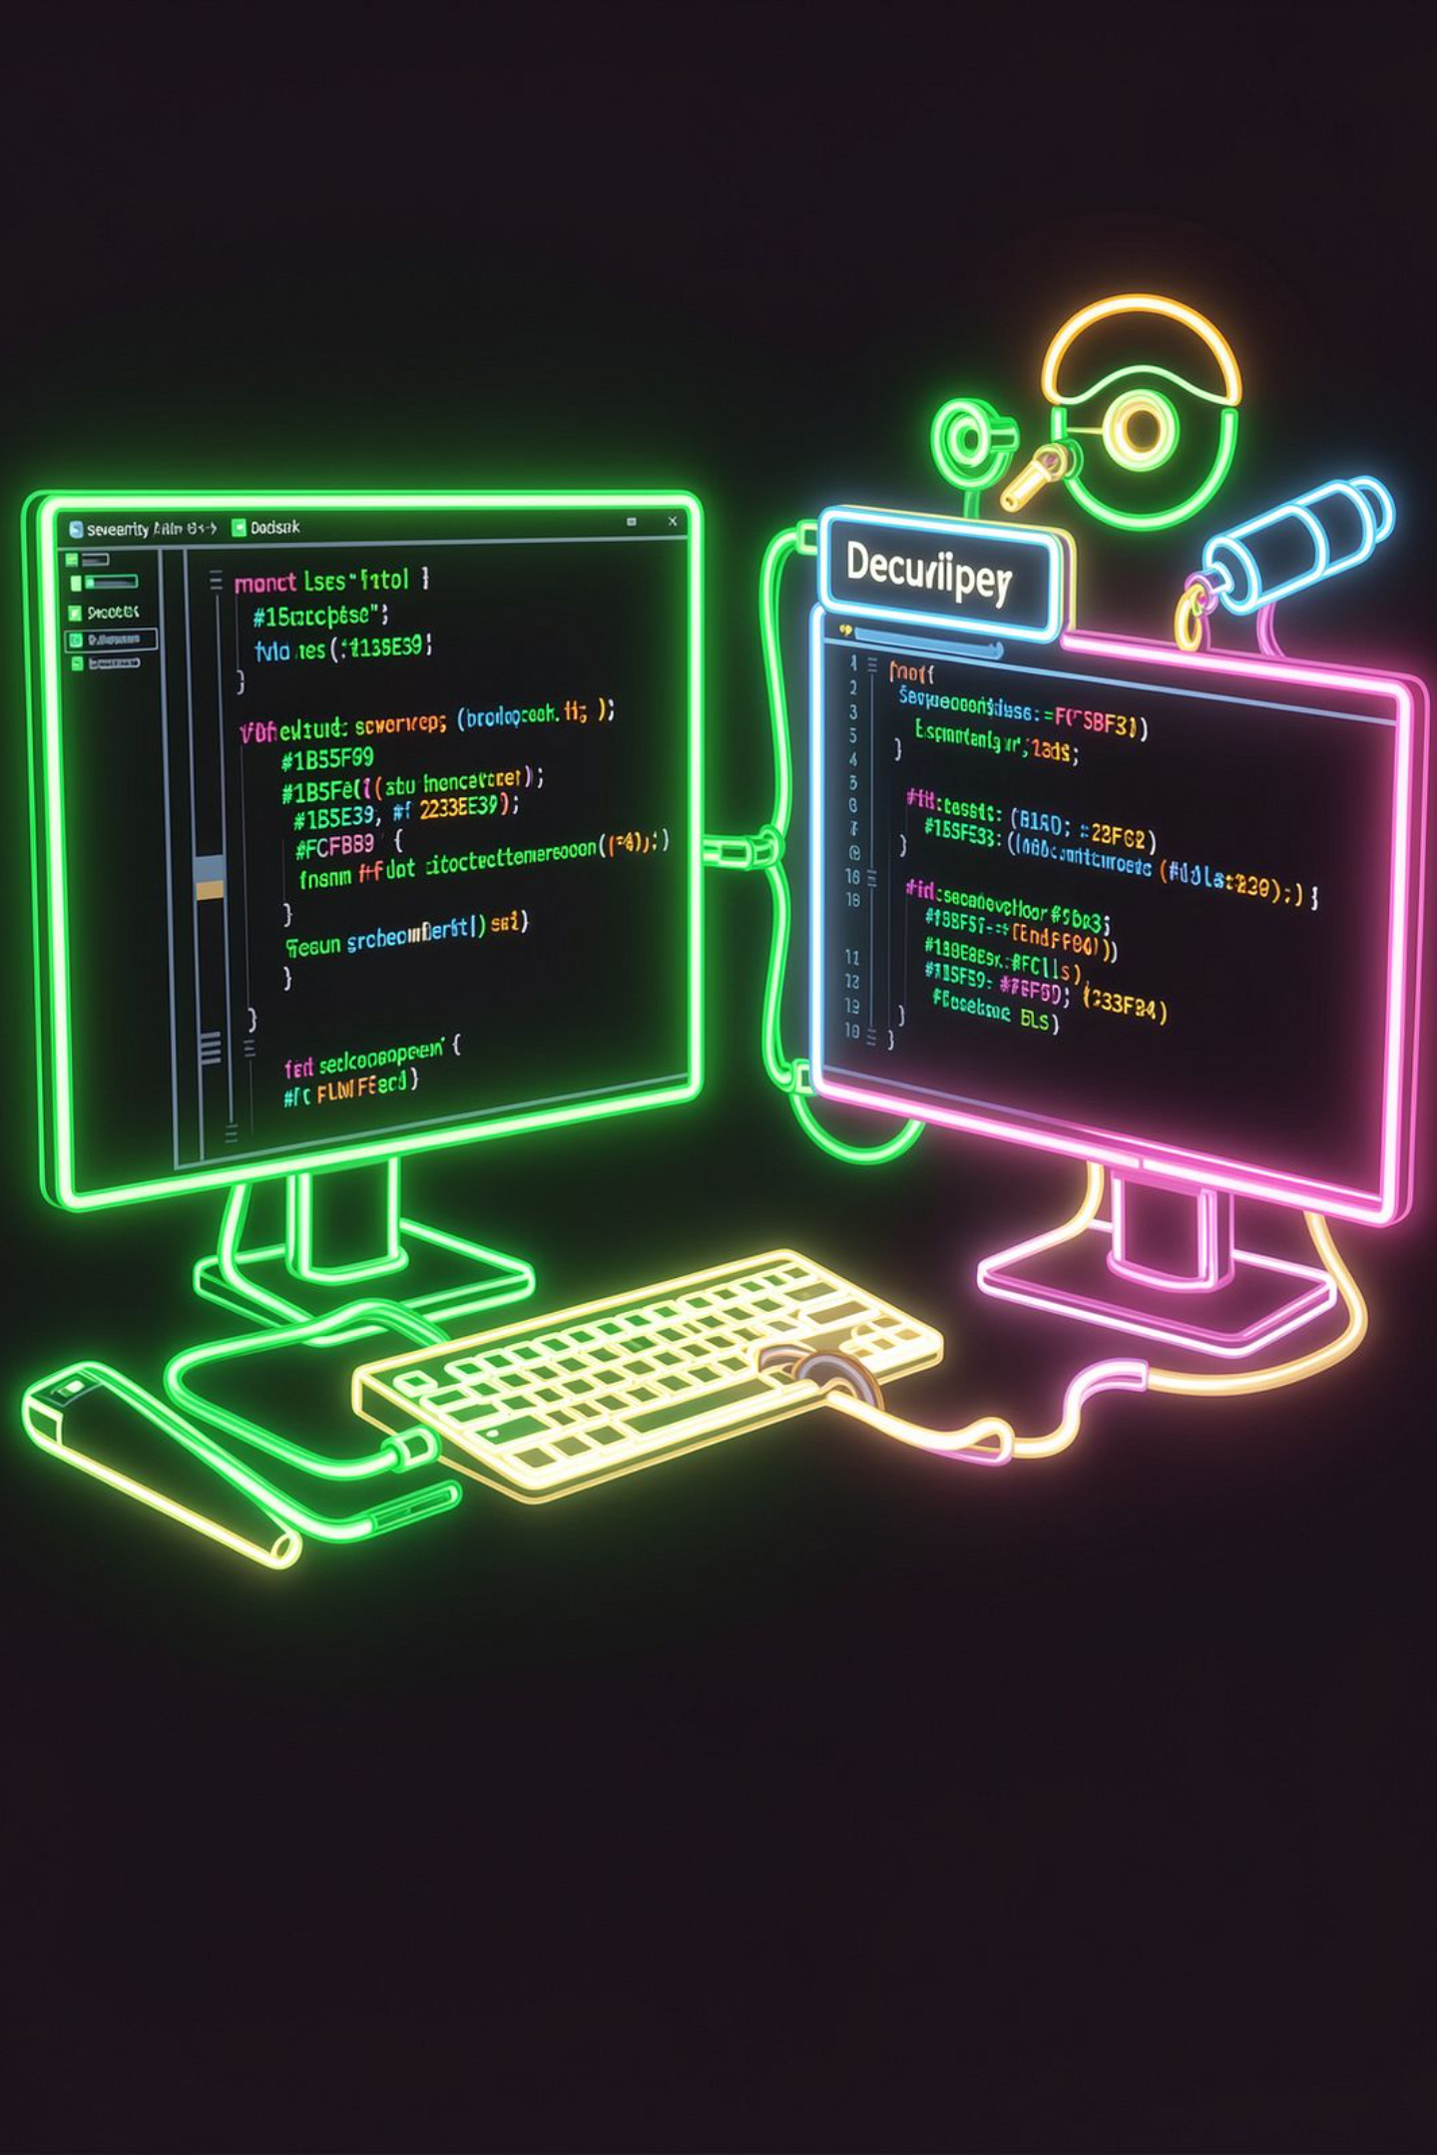

Methodology
Code Review Approach
Two complementary methods were used to thoroughly assess the application's security posture — combining human expertise with automated tooling.
Manual Code Inspection
Static Analysis — Bandit
Line-by-line review of source code to identify logic flaws, insecure patterns, and design weaknesses that automated tools may miss.
Python-specific security analyzer that scans for common vulnerabilities like unsafe input handling, hardcoded credentials, and weak cryptography.
Code Quality — Flake8
Style and quality checker enforcing PEP 8 standards, helping surface inconsistent or potentially problematic code constructs.

Slide 4

Vulnerability #1
Lack of Input Validation
⚠️ The Problem
✅ The Fix
User-supplied input (e.g., interface name) is passed directly to sniff() with no validation. A malicious user could supply an invalid interface, causing crashes or unintended behavior.
Validate input against a whitelist of available interfaces before use. This prevents arbitrary or malicious values from reaching the underlying system call.
interface = input("Enter interface: ")
sniff(iface=interface) # Dangerous!
interface not in get_if_list():
prif int("Invalid interface")
return
sniff(iface=interface)
Key Principle: Always validate and sanitize user inputs. Prefer whitelisting over blacklisting — only allow known-good values.

Slide 5
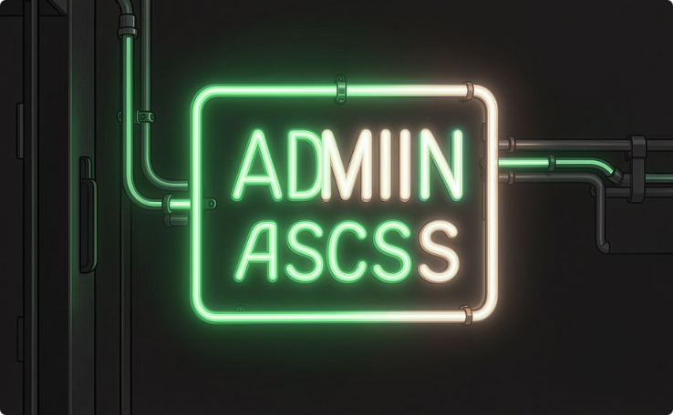
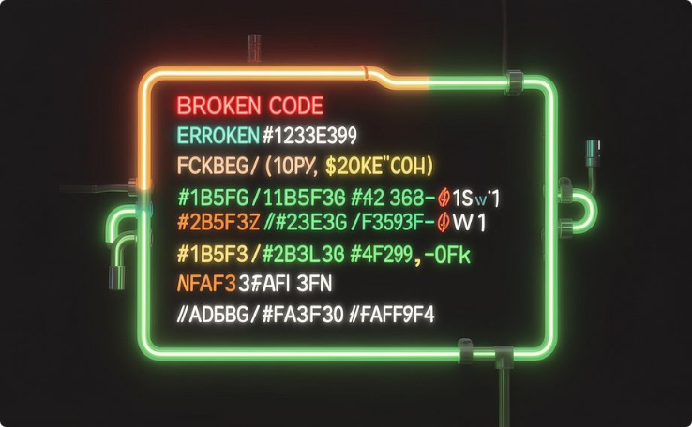
Vulnerabilities #2 & #3
Elevated Privileges & Missing Exception Handling
Running with Elevated Privileges
No Exception Handling
Packet sniffing requires root/admin access. If exploited, an attacker gains high-level system control. Recommendation: Run with least privilege, use a sandbox or container (e.g., Docker) to isolate the process from the host system.
Runtime errors cause unhandled crashes, potentially enabling Denial of Service (DoS) attacks. Wrap all risky operations in try/except blocks and avoid exposing internal error details to users.
try:
sniff(iface=interface)
except Exception as e:
print("Error:", e) # Log internally, show generic message

Slide 6
Vulnerabilities #4 & #5
Sensitive Data Exposure & No Logging
Sensitive Data Exposure
Missing Logging Mechanism
The original code prints raw packet payloads directly — potentially exposing passwords, session tokens, and personal data in plain text on screen or in logs.
Without an audit trail, it's impossible to detect attacks, debug issues, or demonstrate compliance. A proper logging system records events with timestamps and severity levels.
# Vulnerable:
print(packet[Raw].load)
# Fixed:
if packet.haslayer(Raw):
print("Payload hidden for security")
import logging
logging.basicConfig(
filename='sniffer.log',
level=logging.INFO
)
logging.info("Packet captured")

Slide 7
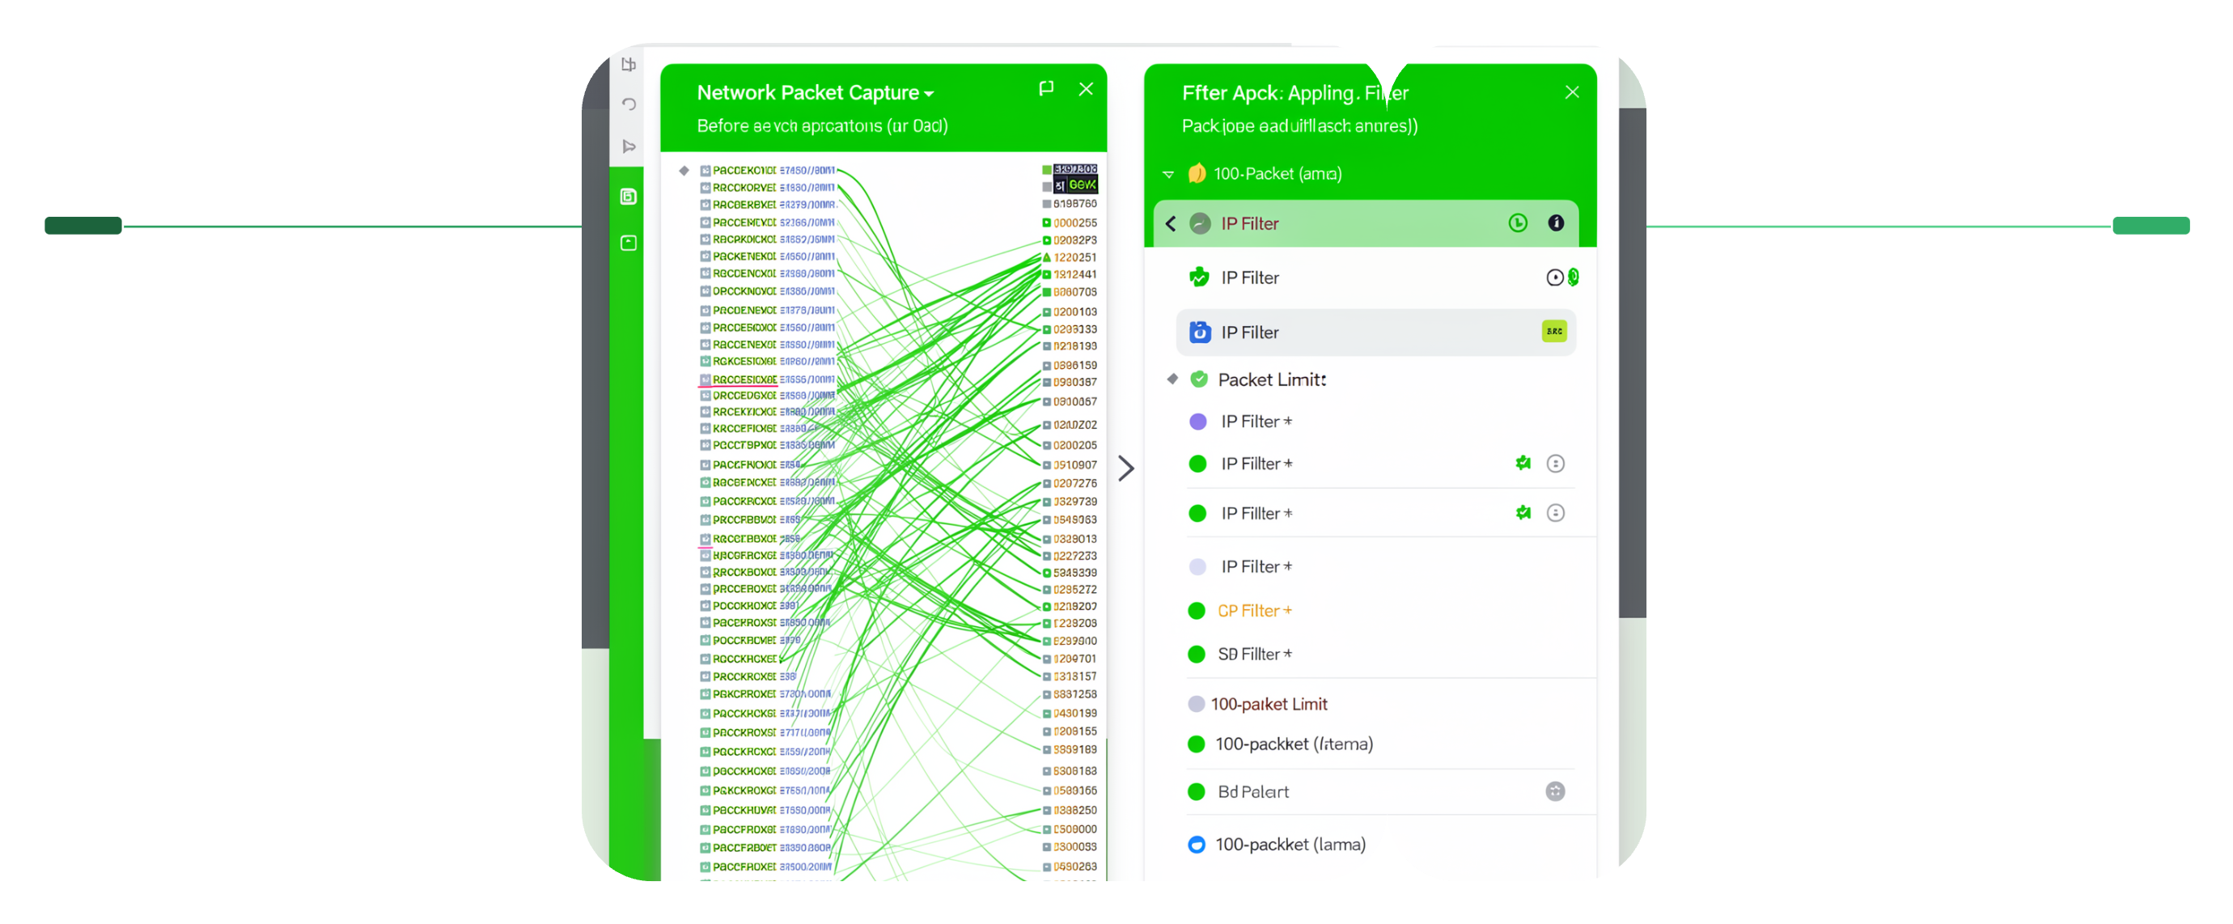
Vulnerability #6
Unrestricted Packet Capture
Capturing all network traffic without filters creates two serious problems: performance degradation from processing unnecessary packets, and expanded exposure to sensitive data that the application doesn't actually need.
Before Capture
After Capture
Captures all traffic with no filters
Applies IP filter and limits to 100 packets
Applying a BPF filter and packet count limit dramatically reduces the attack surface and resource consumption.
Before — Risky
After — Safe
sniff() # Captures everything
# No limit, no filter
sniff(
filter="ip", # Only IP traffic
count=100 # Stop after 100 packets
)

Slide 8
Automated Findings
Static Analysis Results — Bandit
Bandit scanned the codebase and flagged three categories of security issues, ranked by severity. These findings guided prioritization of remediation efforts.
Issue Type
Description
Severity
Sensitive Data Exposure
Raw packet payloads printed without masking
🔴 High
Use of Insecure Input
User input passed directly to system functions
🟡 Medium
Missing Exception Handling
No try/except around risky operations
🟢 Low
3
1
100%
Issues Found
High Severity
Remediated
Across all severity levels
Requires immediate attention
All issues addressed in fix plan

Slide 9
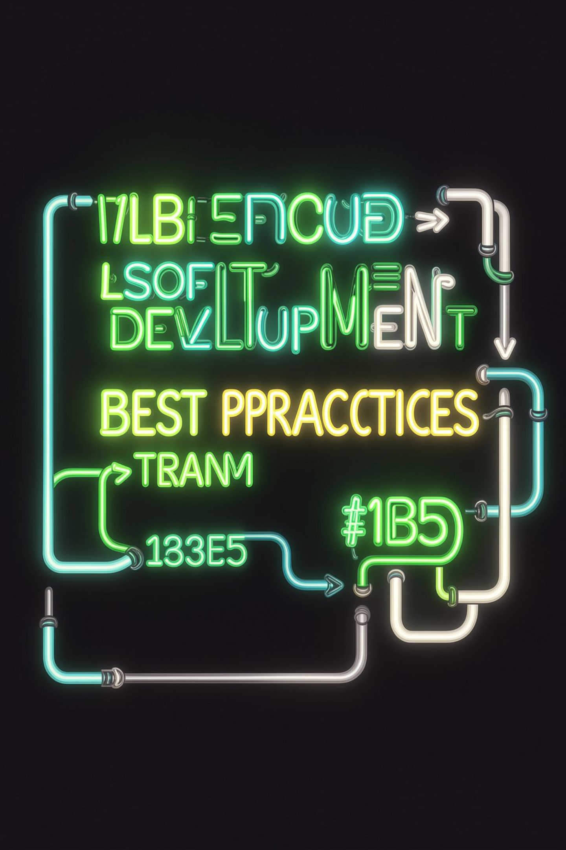
Going Forward
Best Practices for Secure Coding
Input Security
Always validate and sanitize inputs. Use whitelisting — only accept known-good values — rather than trying to filter out bad ones.
Least Privilege
Never run applications as admin/root unless absolutely necessary. Use containers or sandboxes to isolate privileged operations.
Error Handling
Wrap all risky operations in try/except blocks. Log errors internally but show users only generic messages to avoid information leakage.
Data Protection & Logging
Mask sensitive data in output. Maintain structured audit logs. Keep all dependencies updated and avoid untrusted third-party packages.

Slide 10

Summary
Recommendations & Remediation Steps
Immediate Fixes
Advanced Improvements
Add input validation using get_if_list() whitelist
Wrap all sniff() calls in try/except blocks
Apply BPF filters and packet count limits
Mask raw payload output to prevent data exposure
Integrate structured logging with logging module
Add a GUI with controlled, role-based access
Encrypt stored log files
Run inside a Docker container for isolation
Schedule regular Bandit scans in CI/CD pipeline
Conduct periodic manual security audits
Conclusion: The reviewed sniffer demonstrates basic functionality but lacked essential security controls. Applying input validation, least privilege, exception handling, and proper logging makes it significantly safer and more production-ready.

